Slide 1
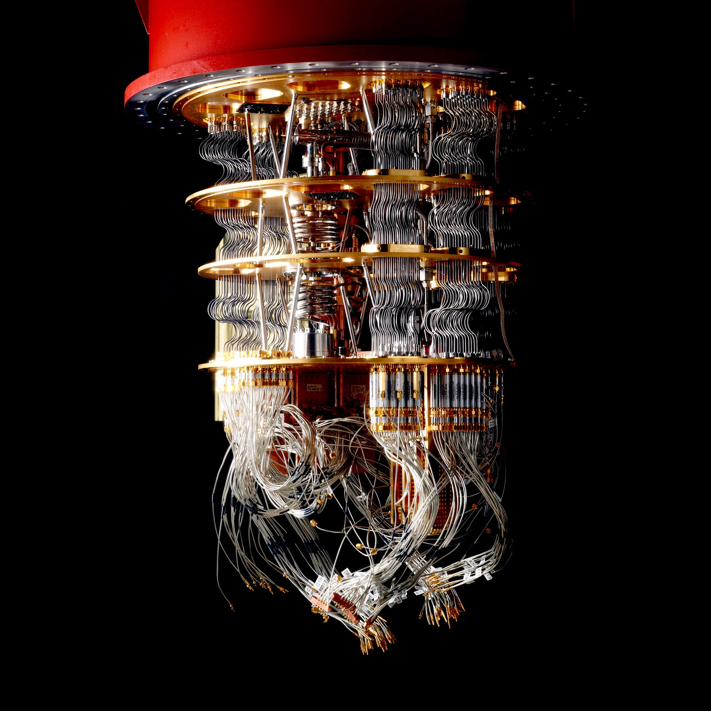
CLASSIFICATION BASED ON ML & QML.
A comparison between the classification between classical and quantum machine learning

Slide 2
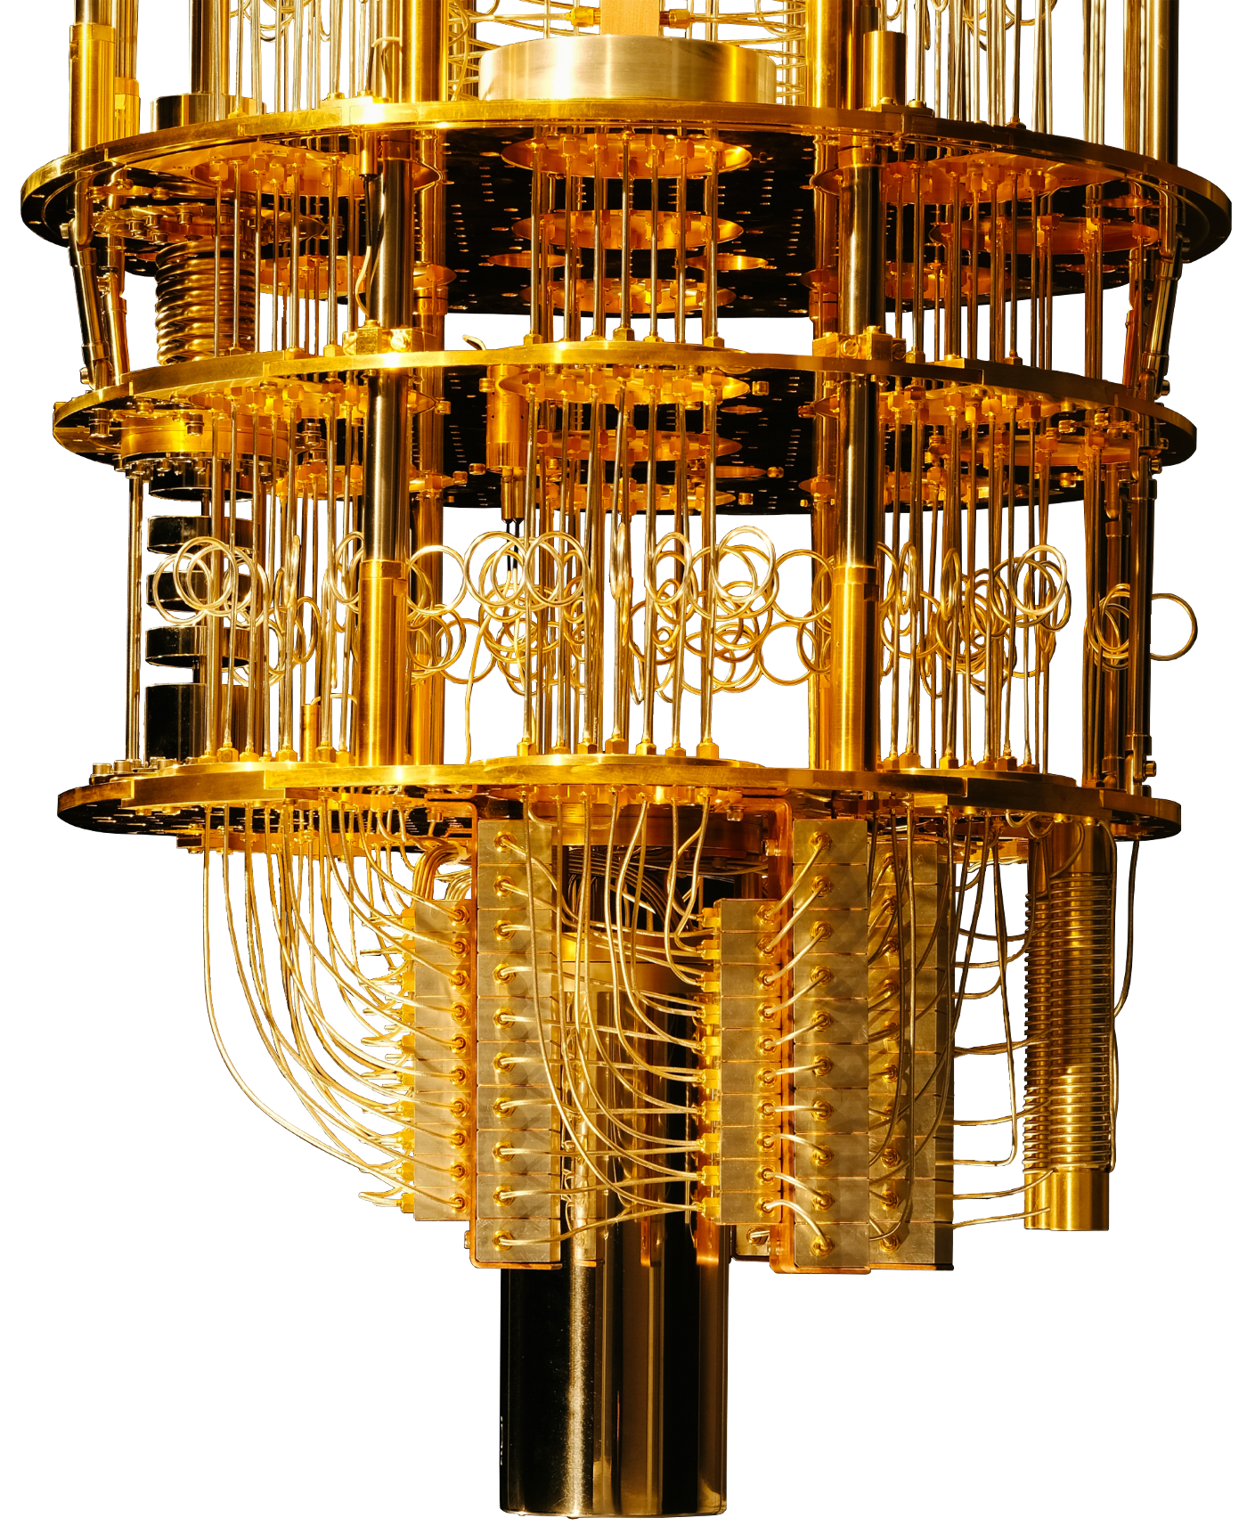
AGENDA:
Problem statement
Know the dataset
Results on classical SVM
The Quantum set-up for VQC
Results of VQC
The Quantum set-up for QSVM
Results on QSVM
Conclusion

Slide 3

PROBLEM STATEMENT
WHAT IS THE GOAL?
To find the best train and test accuracy for classification using one or more Quantum Machine Learning (QML) Algorithm in a noisy environment.

Slide 4
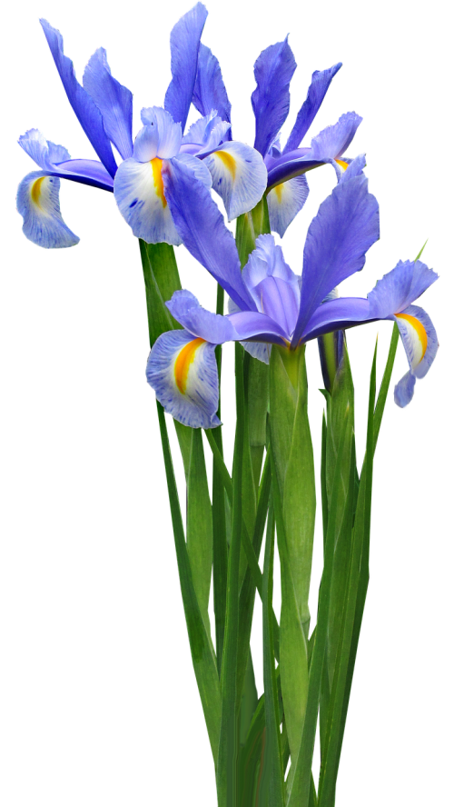
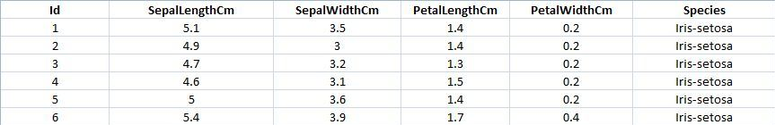
KNOW THE DATASET
THE DATA WE WORKED WITH
Dimension: 150 x 6.
Columns: ID, Sepal width (1), Sepal width(2), Petal length(3), Petal width (4), and Class (results).
3 classes: Iris-setosa (0), Iris-versicolour (1), and Iris-virginica (2).

Slide 5
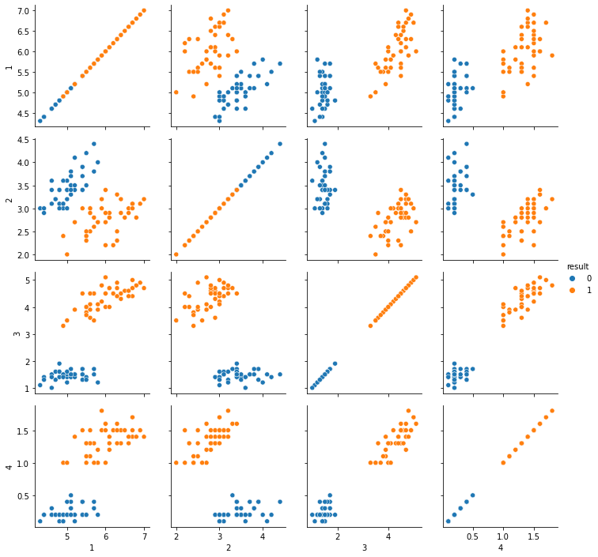
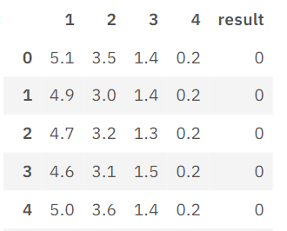
We performed binary classification on classes 0 and 1.
We used the method of forward-selection to select the features that gave the highest accuracy.
The training dataset formed was of 80 x 5 dimension, where the first 40 samples belonged to class 0 and the last 40 belonged to class 1.
The first 4 features were the sepal and petal lengths and widths respectively.
The last feature was the class label.
Similarly, the test dataset formed had a dimension of 20 x 5.

Slide 6
THE CLASSICAL RESULTS
Using 2 features
 | Feature 1 Feature 2 | Feature 1 Feature 3 | Feature 1 Feature 4 | Feature 2 Feature 3 | Feature 2 Feature 4 | Feature 3 Feature 4
Training accuracy | 1.0 | 1.0 | 1.0 | 1.0 | 1.0 | 1.0
Time taken to converge (s) | 0.0018 | 0.0014 | 0.0009 | 0.0008 | 0.0009 | 0.0009
Linear kernel was used in the classical SVM.
Test maximum accuracy after training the model using all the combination of features is 1.0.
Using 4 features
 | Feature 1 Feature 2 Feature 3 Feature 4
Training score | 1.0
Time taken to converge (s)
Using 3 features
 | Feature 1 Feature 2 Feature 3 | Feature 1 Feature 3 Feature 4 | Feature 1 Feature 2 Feature 4 | Feature 2 Feature 3 Feature 4
Training accuracy | 1.0 | 1.0 | 1.0 | 1.0
Time taken to converge (s) | 0.001 | 0.0008 | 0.0008 | 0.0007

Slide 7
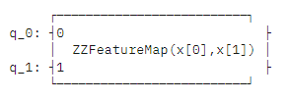
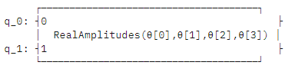
THE QUANTUM SETUP FOR VQC
Feature Maps: ZFeatureMap, ZZFeatureMap
Feature Map used: ZZFeatureMap as we wanted to use the entanglement parameter. ZFeatureMap does not provide entanglement parameter. We have used two repetitions of this for better performance. Repetition of 3 or 4 was increasing the depth of the circuit, also inducing noise at gate level and the score was going down.
Entanglement tried: Linear, Circular, Full, SCA (shifted-circular-alternating)
Entanglement used: Full (Every qubit is entangled with each other), out of all the entanglement options available, ‘full’ entanglement is providing the best result.
Ansatz: We have used RealAmplitudes as the ansatz.

Slide 8
THE QUANTUM SETUP FOR VQC
(Continued)…
Noise is introduced at the following level : Bit Flip, Phase Flip, Phase Amplitude Damping.
Noise is given at 5% for each.
Classical Optimizers: COBYLA, L_BFGS_B.
Optimizer used: COBYLA, due to faster convergence rate on out dataset with a significant good accuracy.
Simulators used: Aer Simulator, with 1024 shots.
The VQC method was used for this classification

Slide 9
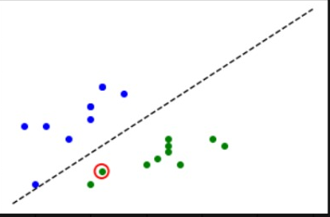
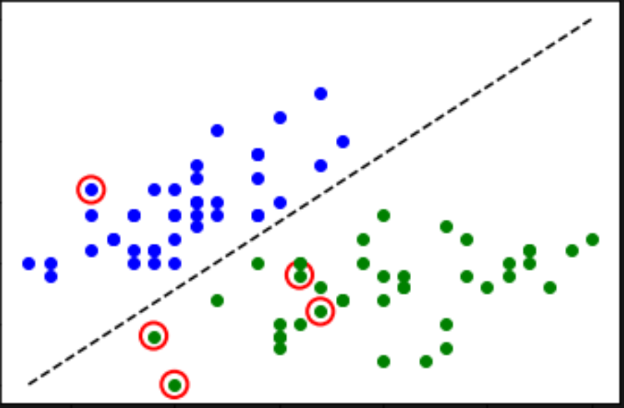
RESULTS OF VQC
Using 2 features
Optimizer = COBYLA |  | Feature 1 Feature 2 | Feature 1 Feature 3 | Feature 1 Feature 4 | Feature 2 Feature 3 | Feature 2 Feature 4 | Feature 3 Feature 4
 | Training accuracy | 0.85 | 0.8625 | 0.725 | 0.775 | 0.9125 | 0.95
 | Time taken to converge (s) | 48.18 | 68.67 | 64.87 | 50.62 | 52.65 | 55.04
Note: Using optimizer = L_BFGS_B, for feature 3 and feature 4, score = 0.9625, time = 186.52 s.
Test accuracy after training it using features 3 and 4 = 0.96.

Slide 10
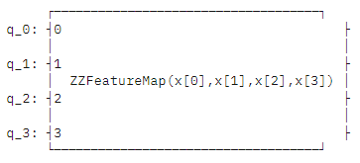
THE QUANTUM SETUP FOR QSVM
Feature Maps: ZFeatureMap, ZZFeatureMap
Feature Map used: ZZFeatureMap as we wanted to use the entanglement parameter. We have used two repetitions of this for better performance. Repetition of 3 or 4 was increasing the depth of the circuit, also inducing noise at gate level and the score was going down
Entanglement tried: Linear, Circular, Full, SCA (shifted-circular-alternating)
Entanglement used: Full (Every qubit is entangled with each other), out of all the entanglement options available, ‘full’ entanglement is providing the best result

Slide 11
THE QUANTUM SETUP FOR QSVM
The QSVC method was used for this classification
Noise is introduced at the following level : Bit Flip, Phase Flip, Phase Amplitude Damping.
Noise is given at 10% for each
Classical Optimizers: COBYLA, L_BFGS_B
Optimizer used: COBYLA, due to faster convergence rate on out dataset with a significant good accuracy
Simulators used: Aer Simulator, with 1024 shots

Slide 12
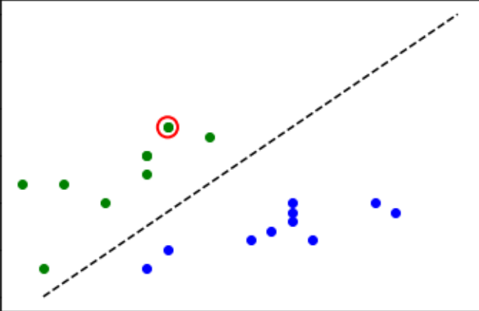
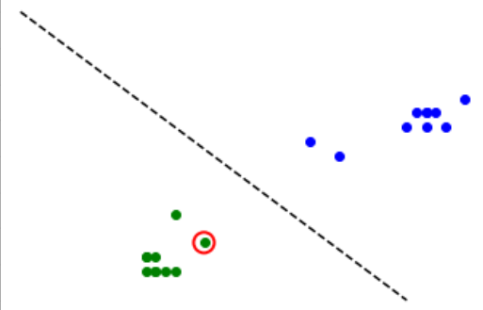
RESULTS OF QSVM
Test accuracy after training the model using all the four features. 0.95.

Slide 13

THANK YOU!
Qiskit Fall Fest Kolkata, 2022
Debdeep Mitra
Sawan Bhattacharyya
Archan Ghosh
Rakhshanda Mujib
HONORABLE MENTIONS

